Slide 1

Financial Data Analysis of Top Companies of India.
By:- Bhawesh Sinha

Slide 2
Introduction
Welcome to our data-driven exploration of India's top companies through the lens of financial analysis. In this presentation, we delve into the intricate world of data science to uncover insights, trends, and patterns within the financial performances of leading corporations shaping India's economic landscape. By leveraging cutting-edge methodologies and robust data analytics, we aim to provide a comprehensive overview of key financial metrics, strategic positioning, and market dynamics influencing these companies. Join us as we navigate through the vast sea of data to gain valuable insights into the financial prowess and potential of India's corporate giants.

Slide 3
Details about the Data.
Name – Name of the Companies.
Mar-Cap in Crore – Total Value of the company in Crore.
Sales Qtr. – Average Sales of each company in quarterly basis.

Slide 4
Main KPIs
Name of The Company
Market Capital
Ranking
Sales in Quarterly basis
Market sales ratio

Slide 5
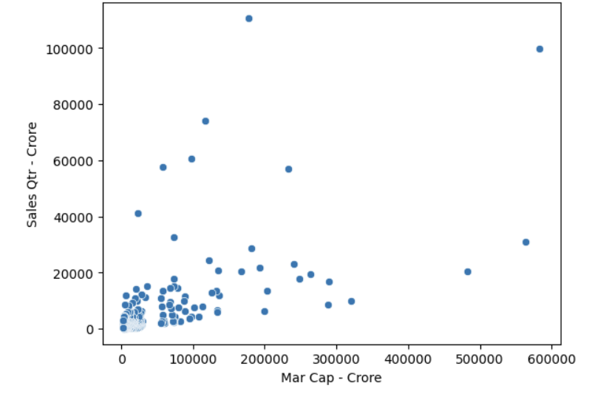
Mock up dashboard
As Market Capital Increases, Sales also increased as well as some companies performed very well.

Slide 6
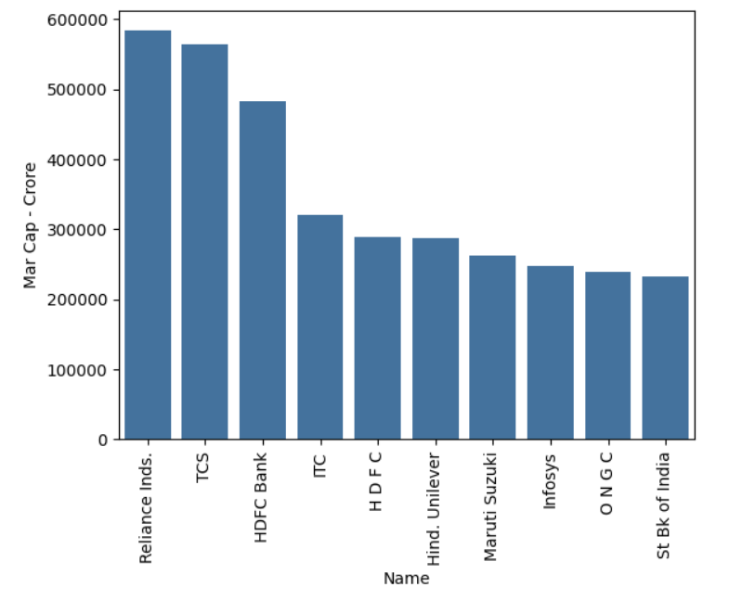
Reliance Industries have the largest Market Capitalization followed by Tata Consultancy Service.

Slide 7
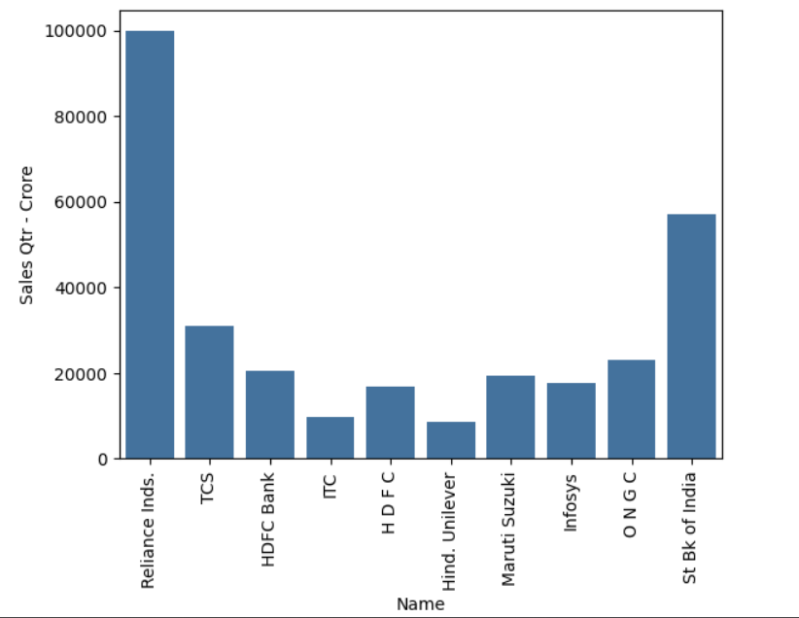
Reliance Industries have the best average in the entire year.

Slide 8
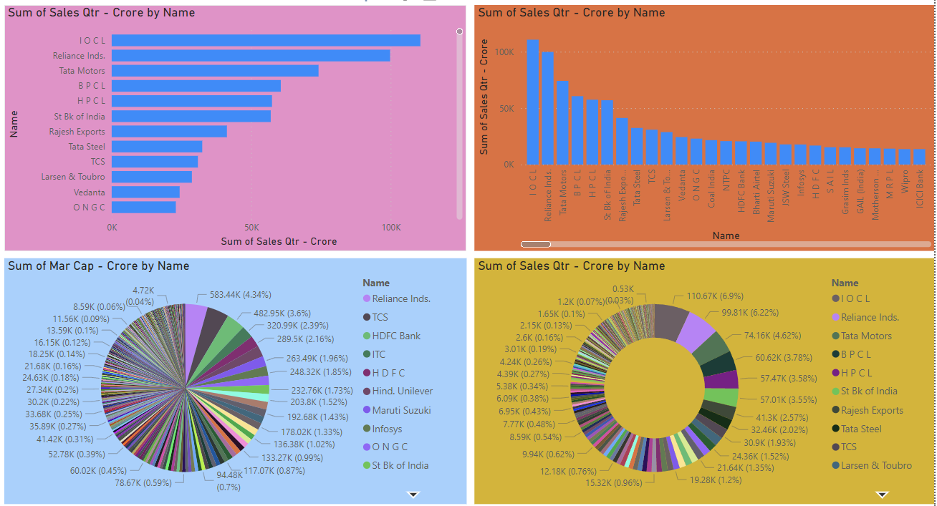
My Design

Slide 9
Thank you

